Slide 1
PEMCO
BIM Retirement & Report Migration
Status Update — May 2026
Bourntec Solutions | PEMCO Mutual Insurance

Slide 2
Previous State
Legacy BIM-Based Reporting Architecture
BIM as the Source of Truth
All enterprise reporting sourced from BIM (Business Intelligence Model)
BIM ran Daily, Weekly, and Monthly ETL jobs from HDS
Major monthly ETL job on the 1st triggered SSIS packages & stored procedures
Data flowed into Production Reporting, PMIC Data Warehouse, and PMIC Data Mart
Reporting Tools in Use
BOXI (Business Objects): Scheduled reports via email & shared drives
SSRS: Proxy and operational reports
Tableau: Multiple disconnected dashboards, each with separate BIM sources
Agent Dashboard: Generated via SSRS from BIM stored procedures
Challenges Driving Migration
BIM retirement mandated migration of all reports to AWM/DWM (Enterprise Data Warehouse)
Table and column names differ between BIM and AWM — business logic must be re-implemented
Some reports pulled from multiple sources (BIM, Data Mart, Production Reporting)
Monthly BIM ETL dependency created latency and a single point of failure

Slide 3
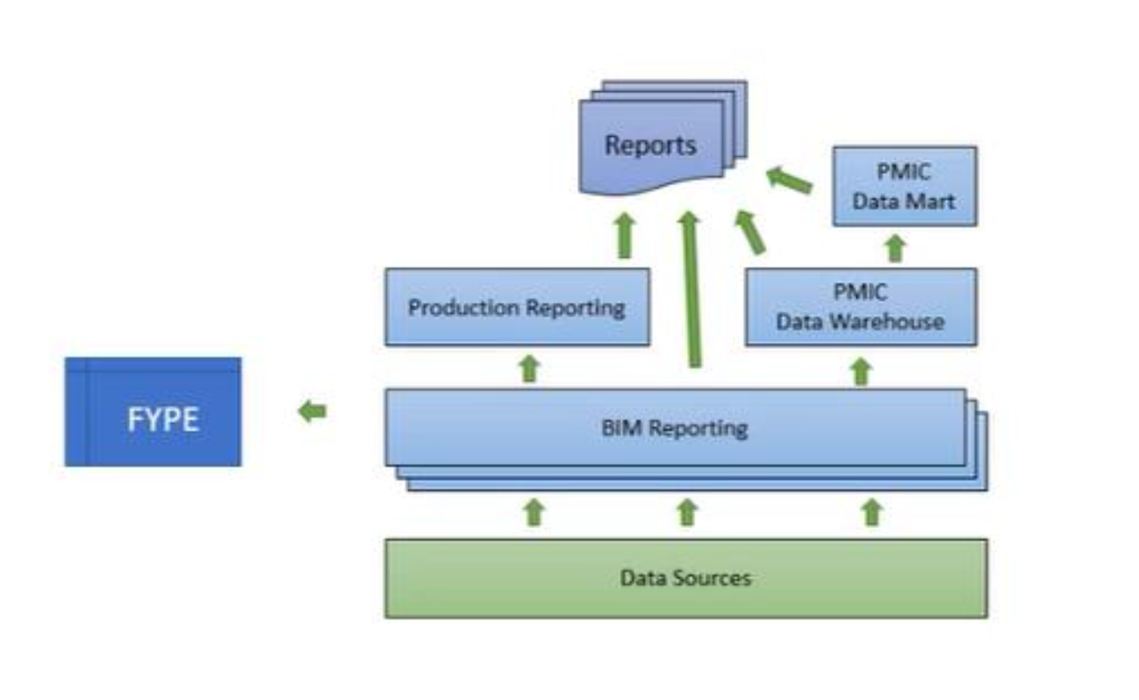
BIM Reporting Architecture
Previous State — Data Flow Overview
Key Points
• BIM served as the central hub — all data originated from BIM Monthly, Weekly, and Daily databases
• Data Sources (Exceed, HDS, external systems) fed BIM via SSIS ETL packages running on the 1st of each month
• BIM fed Production Reporting tables consumed by SSRS and BOXI for report generation
• PMIC Data Warehouse and PMIC Data Mart were downstream layers also sourced from BIM
• Final reports (BOXI, SSRS, Tableau) were served from Production Reporting and PMIC Data Mart layers
• FYPE received a separate data feed from BIM outside the standard reporting path
• This BIM-centric design created a single point of failure — any ETL issue delayed all reporting

Slide 4
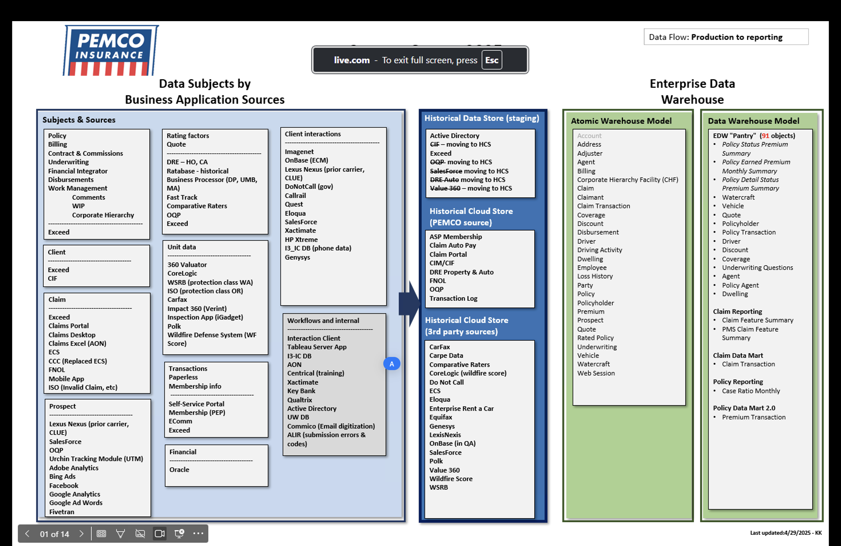
Current System Architecture
End-to-End Data Flow — Business Sources to Enterprise Data Warehouse

Slide 5
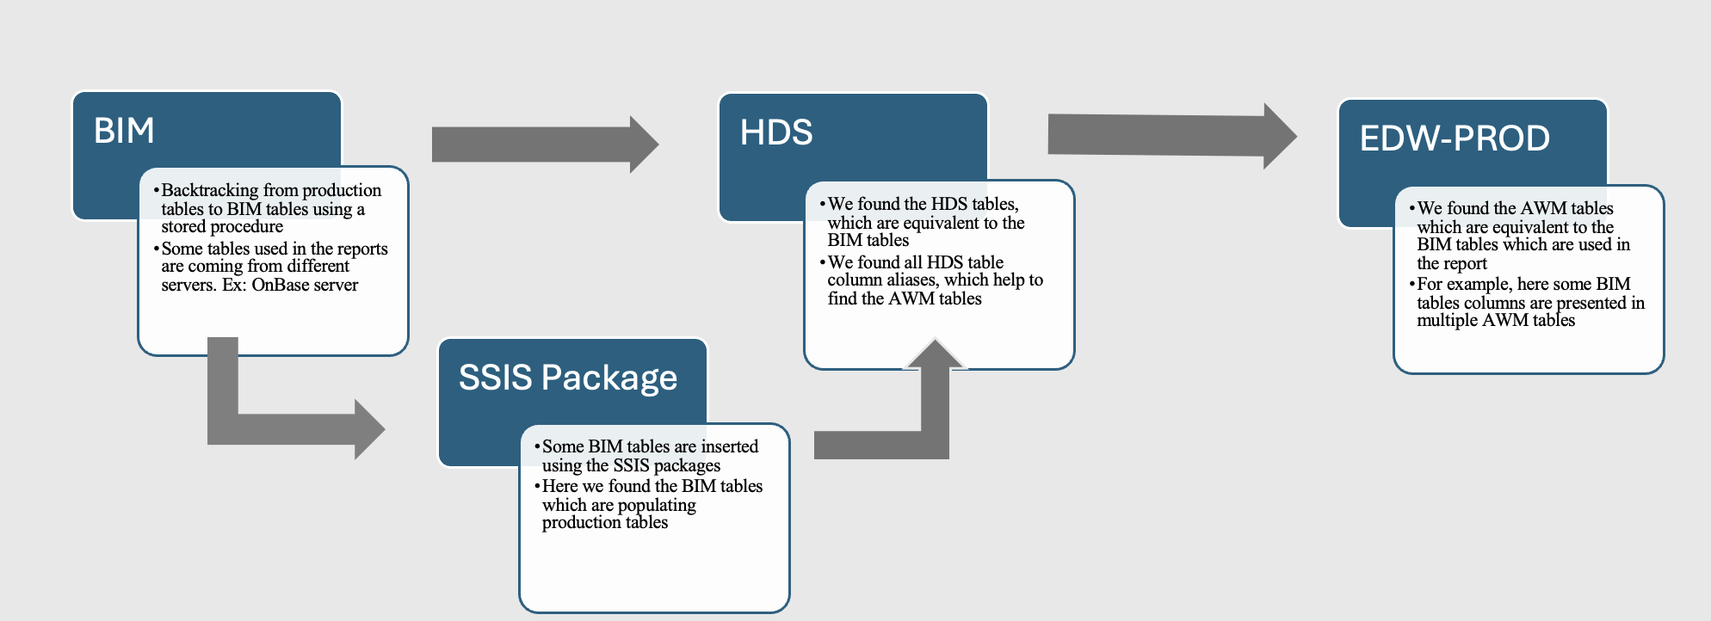
BIM to EDW-PROD Lineage Mapping
Migration Methodology — Tracing from BIM to AWM/DWM

Slide 6
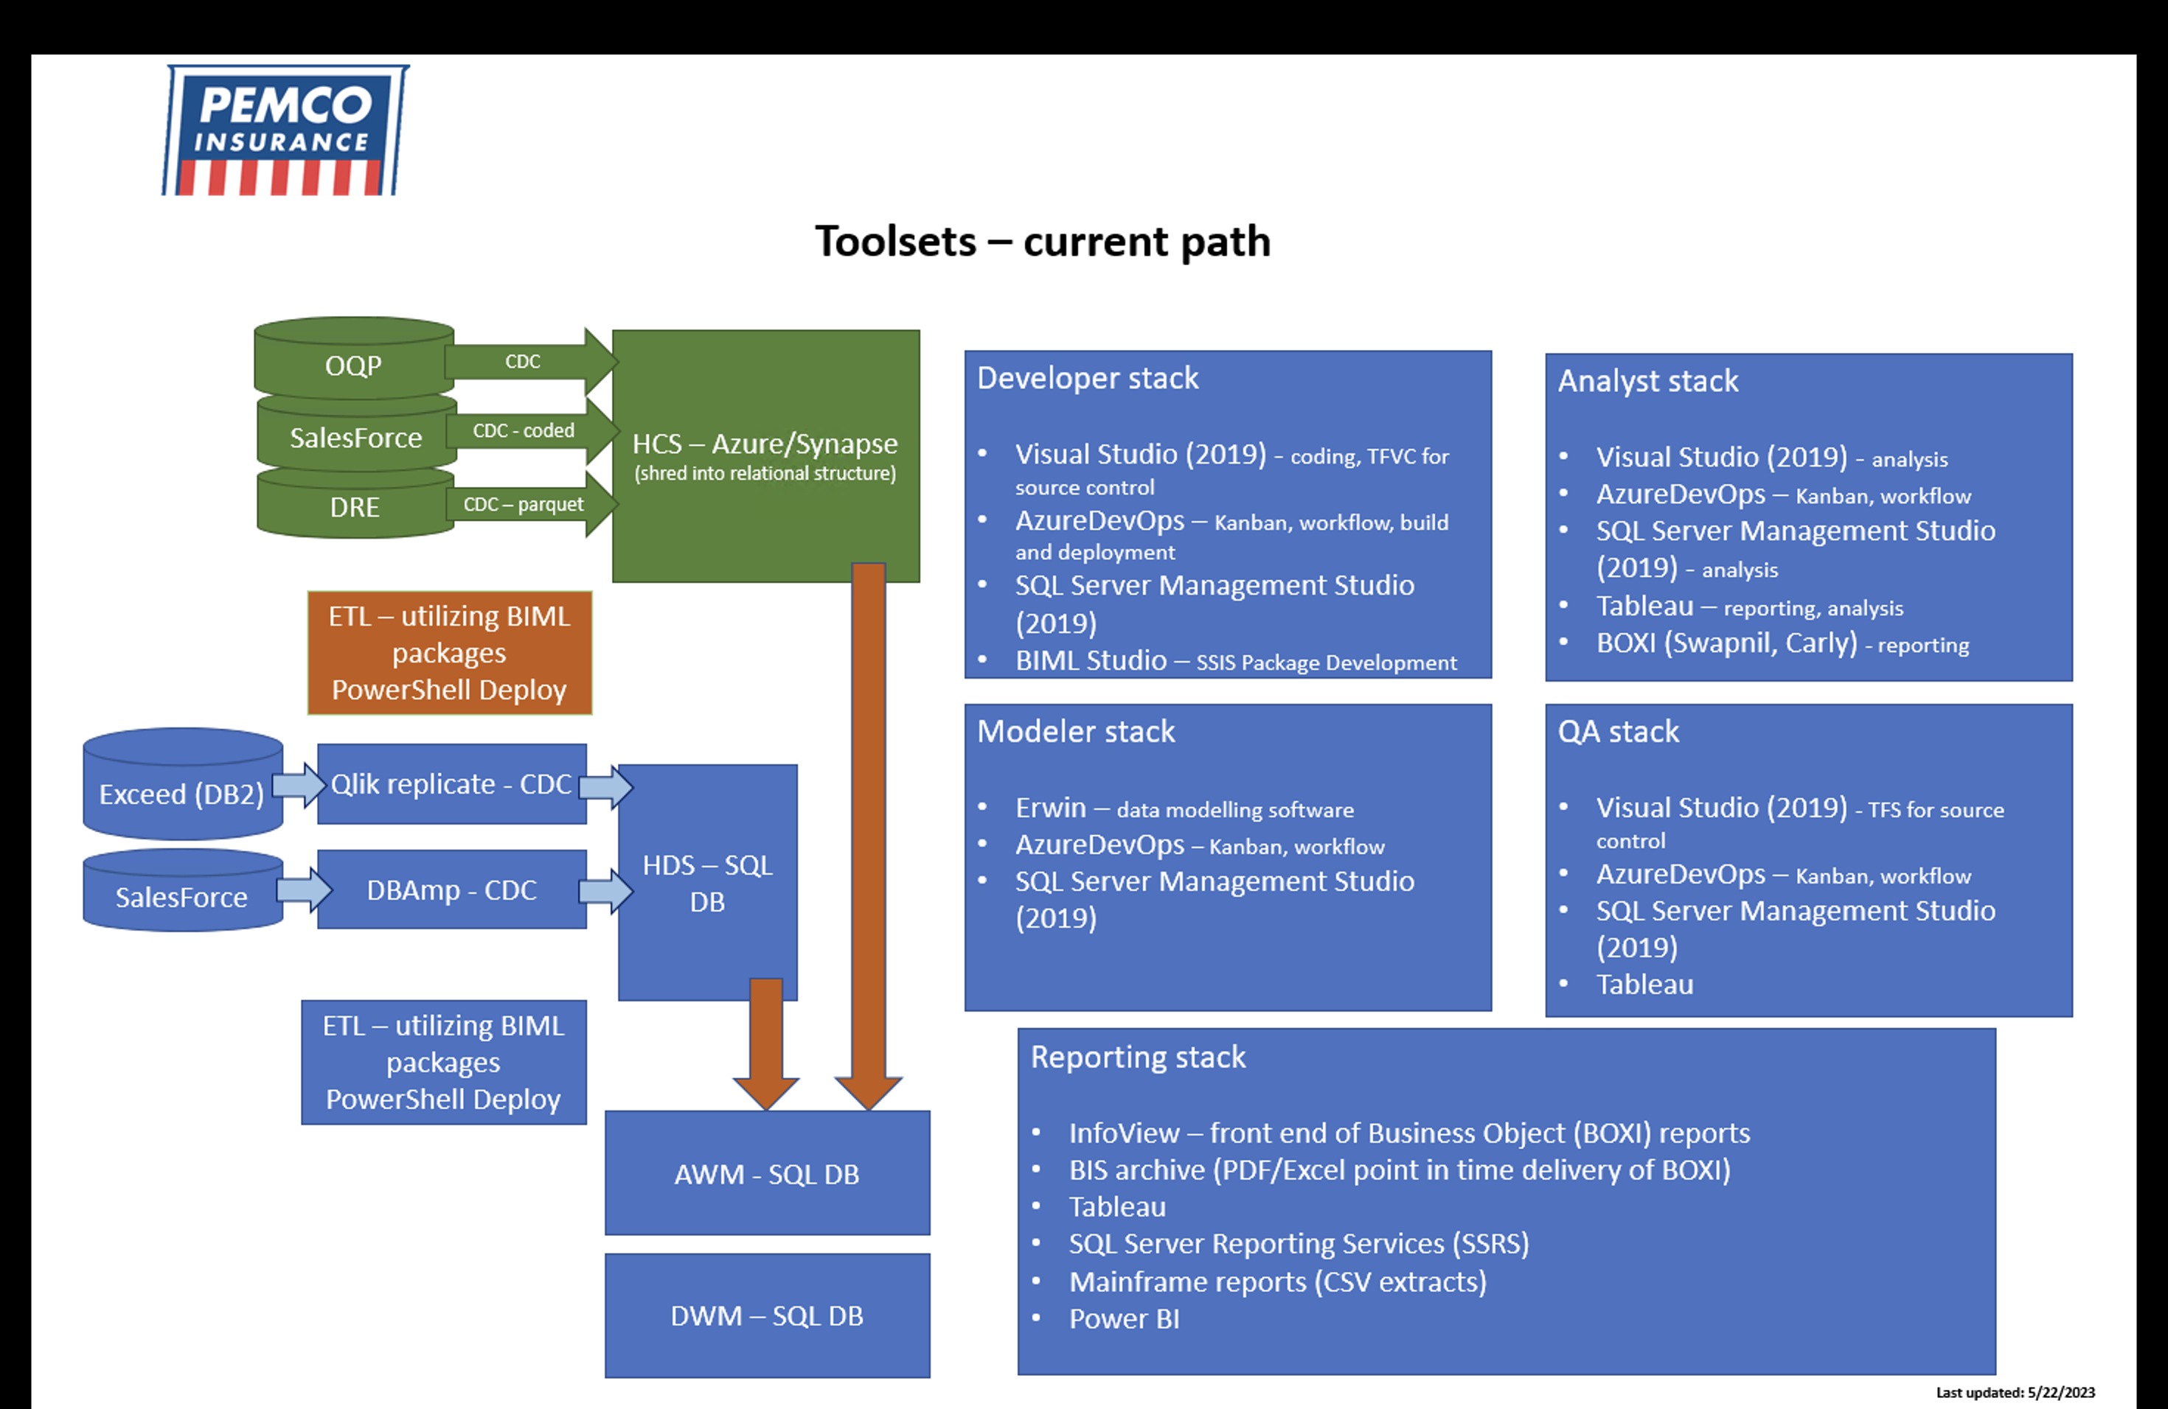
Toolsets — Current Path
Developer, Analyst, Modeler, QA & Reporting Stacks

Slide 7
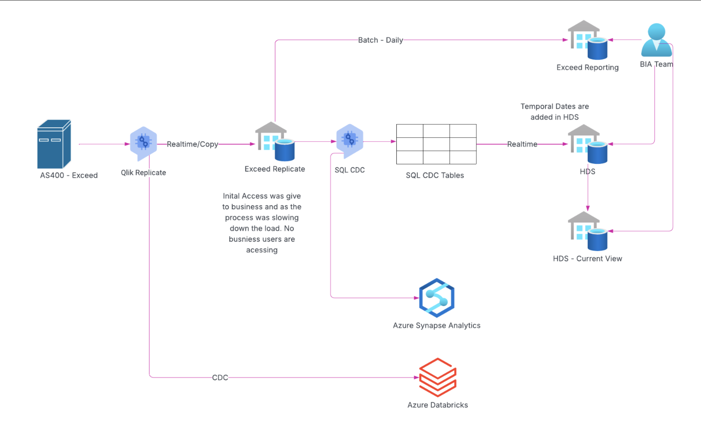
New Architecture

Slide 8
Our Task
Scope of Work — BIM Retirement & Migration
BOXI → Power BI
BOXI / SSRS → Tableau
Migrate 4 BOXI reports to Power BI per Ellen's requirement. No AWM/DWM dependency — direct BIM to Power BI rebuild.
Migrate remaining BOXI (3) and SSRS Proxy reports (3) to Tableau. Source migrated from BIM to AWM/DWM.
Tableau Consolidation (Single Source Report)
Agent Dashboard
Consolidate 5 separate Tableau reports into one unified report. Migrate data source from BIM to AWM/DWM.
Fix data issues in the existing Agent Dashboard SSRS report. Reconcile and resolve BIM vs EDW (AWM/DWM) variances across EP, WP, Inforce, and New Business.

Slide 9
What We Accomplished
Completed Migrations — All Reports Status
BOXI → Power BI (Ellen's Requirement) | 4 Reports | Complete
✓ Agent Loss Experience Report (O0140A-M1A-P01)
✓ Agent Loss Experience Report — Current 12 Months
✓ Billing Accounts with Suspended Disbursements (O0169A-W1C-P01)
✓ Monthly Direct Sales Incentive Count Report (O0489A-M5P-P01)
BOXI / SSRS → Tableau | 6 Reports | Complete
✓ Monthly Inforce Household and Policy Unit Counts (O0300A-M1C-P01) | Monthly Manual Write Off (O0242A-M1A-P01) | Monthly Write Off (O0302A-M1B-P01)
✓ Monthly_Proxy_Emailed_Detail | Monthly_Proxy_Emailer_Dashboard | Monthly_Proxy_Received_Detail
Tableau Consolidation — Single Source Report | 5 → 1 Report | Complete (minor data issues)
Paper Report | Online Accounts - Household & Paperless | Paperless Policies by State and Policy Type | Percent of Households with Online Accounts | Paperless Online Accounts
→ Consolidated into one unified Tableau report. Source migrated from BIM to AWM/DWM.
Other Tableau Dashboards | Complete / Partially Complete
✓ Engagement Dashboard | ◑ Quote to Purchase Online & DIA (blocked — Salesforce table pending) | ◑ Online Accounts (UserEvents table pending)
Agent Dashboard | Existing SSRS Report | Data Issue Resolution In Progress
Reconciling BIM vs EDW variances across Earned Premium, Written Premium, Inforce, and New Business.

Slide 10
Single Source Tableau Report
Consolidation & Migration — BIM to AWM/DWM
Before
5 separate Tableau reports, each with independent BIM data connections
Duplicate logic and maintenance effort across reports
Source: BIM (Monthly ETL-dependent)
Reports: • Paper Report • Online Accounts - Household and Paperless • Paperless Policies by State and Policy Type • Percent of Households with Online Accounts • Paperless Online Accounts
After
1 unified Tableau report replacing all 5
Single shared AWM/DWM data source — no BIM dependency
Reduced maintenance and eliminated data inconsistency
Consistent definitions across all views in the report
Status: Complete ✓
→
Pending
Minor data issues currently under investigation
AWM/DWM source data validation ongoing

